Slide 1
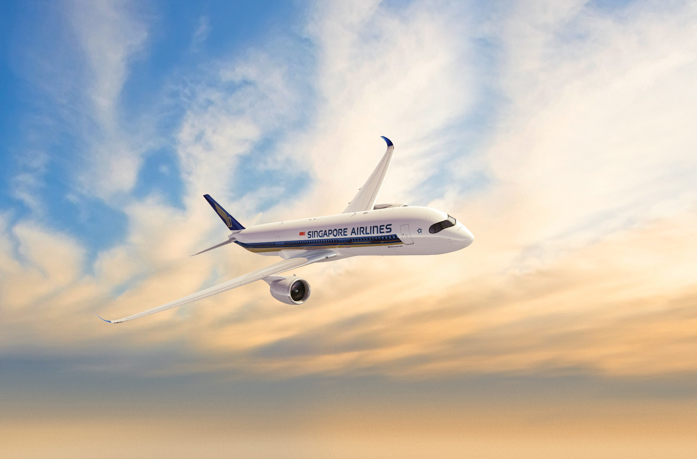


LOCATION
BASED
GROUND
TOUR
APP CHALLENGE 2019
ROARING WHALE

Slide 2

Location Based Ground Tour
Make Air Interesting Again
Make Air Interesting Again
Watching from Sky
Interacting from Sky
Experiencing from Sky
Watching from Sky
Interacting from Sky
Experiencing from Sky

Slide 3





Team Introduction
Roaring
Whale
Creative team
from Shenzhen, China
with members of
Programmers, Trekkers, Explorers
and focus on
AR IOTA SLAM LBG
David
Nick
Alex
Nalon
Design + Program
Tech Expert
UI/UX Designer
Design + Project
Project Expert
Product Designer
Market
Sale Expert
Program
Software Expert

Slide 4


The Problem / Opportunity
Today people flying always, and tired of the services provided by plane.
Most of people are just SLEEPING during the whole trip :(
NEW SERVICE MUST BE CREATED
Why is it important?
How big is the problem?
Who does it affect?
People will choose an Airlines with better experiences besides price.
Commercial services could be accepted by people during the trip.
I have no accuracy statistic data about the percentage of passengers who are sleeping, but we all have seen the facts.
I am sleeping always, boring.
Plane is flying, Ground is changing. These dynamic information are interesting and never be boring if service based on them.
Every passengers will be involved in the service.

Slide 5

Research Findings
“
My Poem of Flying
Referenced Statistics
https://www.jianshu.com/p/b34594f3b3df
Flying more
Boring more
Pad, Magazine and TV Show
OUTDATED THEM ALL
Sit beside window
Watch inside sky
Plane flying
Ground changing
View amazing
Scaling, Rotating and Transforming
Want more manipulation
Sleeping = 80%
Watching Pad = 10%
Chatting = 6%
Watching TV = 2%
Watching Magazine = 2%
I do not known any such service provided by Airline Companies
It is attractive to boring people,
that is to say …. 80% passengers
WHAT SHOULD WE DO

Slide 6


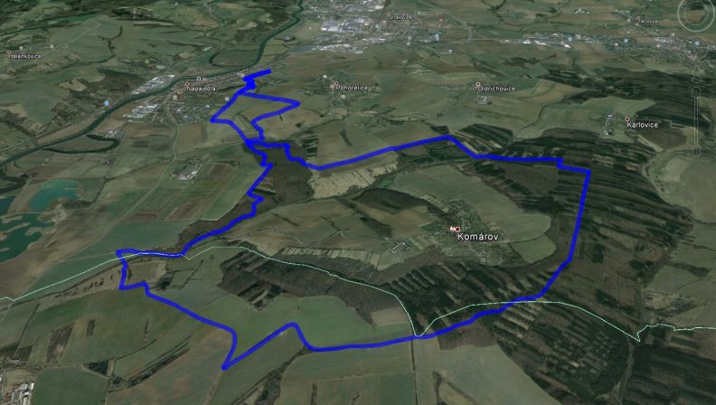
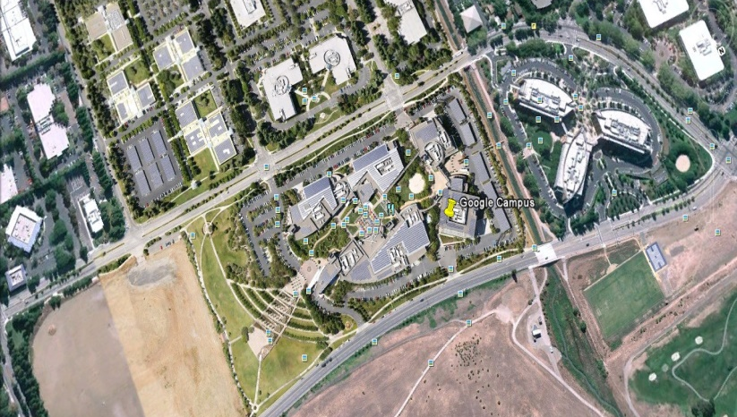
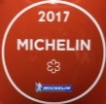
Scenario
Our Idea
Passengers can see and manipulate Ground View.
Ground View changes according to the location of plane.
Dynamic Information are layered onto the Ground view.
Passengers can interact with interesting information, or chat with other passengers, or play games
Nan Chi
French Style
40 Seats
$30 per person
Xiao Lu
Book Now
16 Km long, Grass covered
Diff.
4 Teams is calling members
Join Other Team
Arrange Private Tour

Slide 7







Our Technology
Cloud
Server
Third
Party
Gateway
Plane Data
Plane Server
Pad
Screen
VR
Plane Data contains GPS and Camera, it is strongly recommended.
Plane Server provides offline service during flying, in order to minimize network connection, and acceptable user reaction delay time. But during parking, Plane Server exchanges data between Plane Server and Cloud Server.
Passenger login by ID Card, Passport. But others can not see it to protect privacy.
Map
Service
Other
Services
Engine

Slide 8
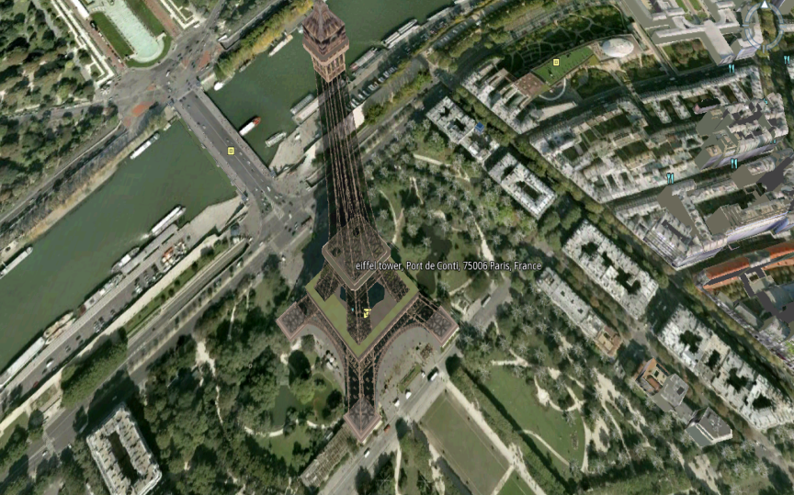


Demo
“
If a picture is worth a 1000 words, a prototype is worth a million slides
Yet we have not implemented the Demo
BUT ….
We have made lots of projects based on the same technology
We knew the key points, including design, develop and operation
Architect
Map Game
Service
Deploy
Maintain
Robust, Delay, Scale
Location, 3D, Layer, POI
RTS, RPG
Hello ~
Partner, Revenue-Share
Engineering, Management
Customer, Quality

Slide 9
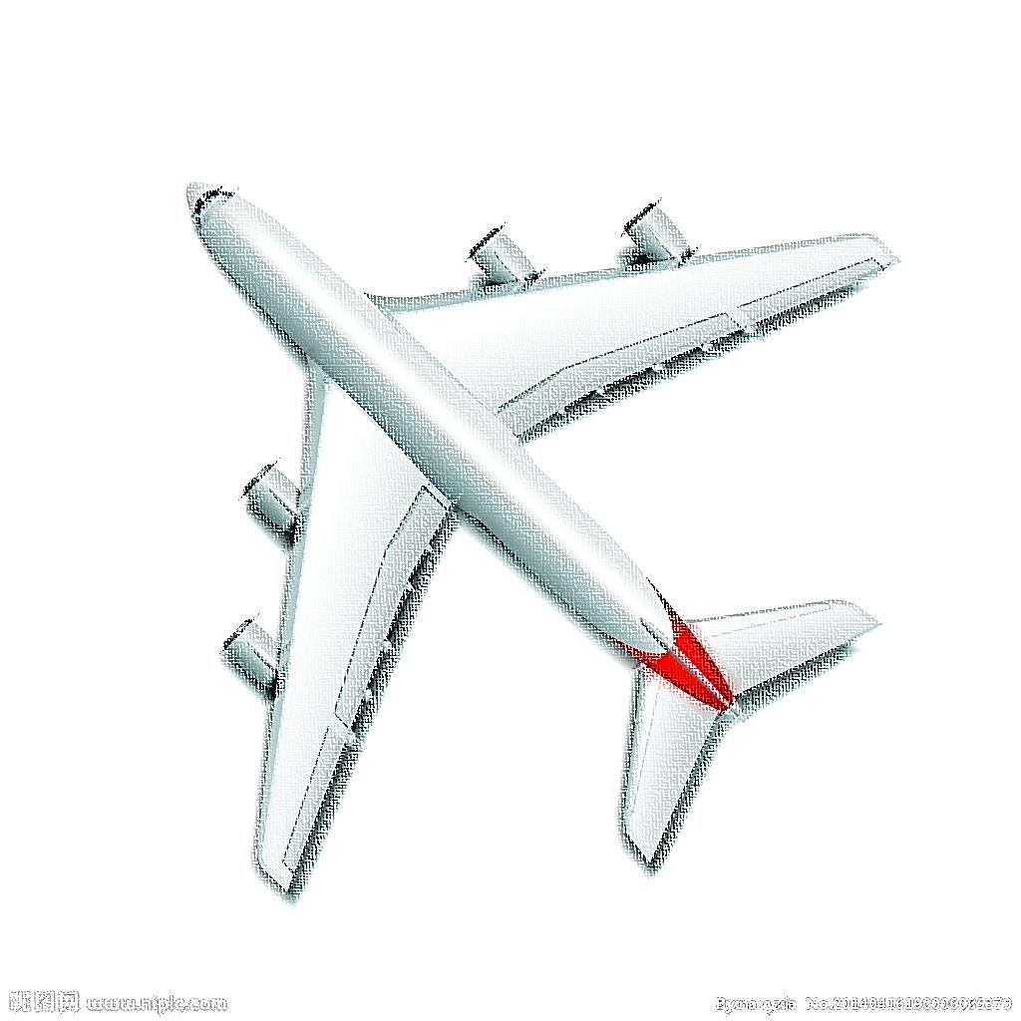


Business Value
EXPERIENCE
EXPERIENCE
TECHNOLOGY
TECHNOLOGY
Business Model
ECONOMICIS
ECONOMICIS
User Free
View, Chat
User Pay
Play Game, Book Service
Third-Party Rebate
Bring Order
Estimated Revenue
Single Aircraft
Avg. Pass. Per Aircraft | Usage Ratio | Payment Conv. Ratio | User | Payment | Payment Per User | Payment | Rebate
200 | 20% | 10% | 40 | 4 | $5 | $20 | $10
Daily Flight
Aircraft | Flight Per Day | Pass. Per Day | User Per Day | Payment Per Day | Rebate Per Day
21 | 50 | 210,000 | 42,000 | $21,000 | $10,500
Annual Income
Repeat Flying Per Pass. | Uni. Pass. Per Year(200Day) | User Per Year(200Day) | Payment Per Year(200Day) | Rebate Per Year(200Day)
5 | 8,400,000 | 1,680,000 | $4,200,000 | $2,100,000
Annual Share
SIA Ratio | Third-Party Ratio | Platform Ratio | SIA Income Per Year | Third-Party Income Per Year | Platform Income Per Year
30% | 0% | 70% | $1,890,000 | $0 | $4,410,000
https://www.ceicdata.com/zh-hans/singapore/singapore-airlines-limited-sq-operational-data
https://data.variflight.com/profiles/Airlines/SQ

Slide 10
Project Plan & Next Steps
Project Plan (Begin from the end of AppChallenge2019 )
Version = ConceptProof + BaseLine + RefinedFeature
Release
CP Version
Deploy & Test
BL Version
Deploy & Test
RF Version
No.
1
2
3
4
5
6
7
Month
Design & Program
Release
BL Version
Release
RF Version
Start
Marketing
Resource Needed ( What resource and who provide it )
Plane Data Interface ( GPS and Camera )
SIA
Third-Party Service
We
Cloud Infrastructure
We + SIA
Test and Deploy Environment ( Plane )
SIA

Slide 11

References
In the past time we have made a lot of games, the following is just some examples:
Treasure Kingdom ( Location Based Game )
Blade MinD : The Doom of Dynasty ( Action RPG )
We have also made lots of projects in the fields of Enterprise Solution, Mobile Payment, Education System and AR.
More information please visit
df595149790.github.com
www.dooyogame.com

Slide 12

THANK YOU
David
DOOYO CEO
www.dooyogame.com

